Slide 1
Video Textures
James Salvatore
Jared Salvatore

Slide 2
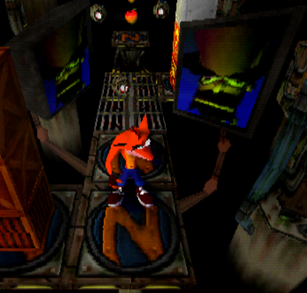
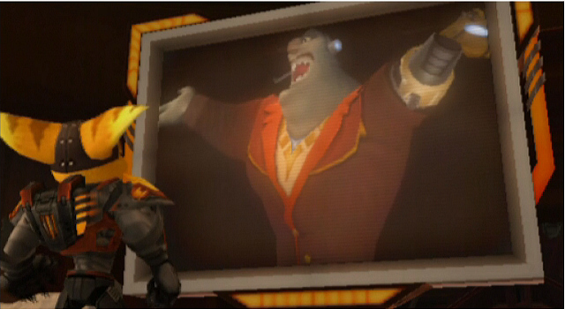
Examples of PlayStation Goodness

Slide 3
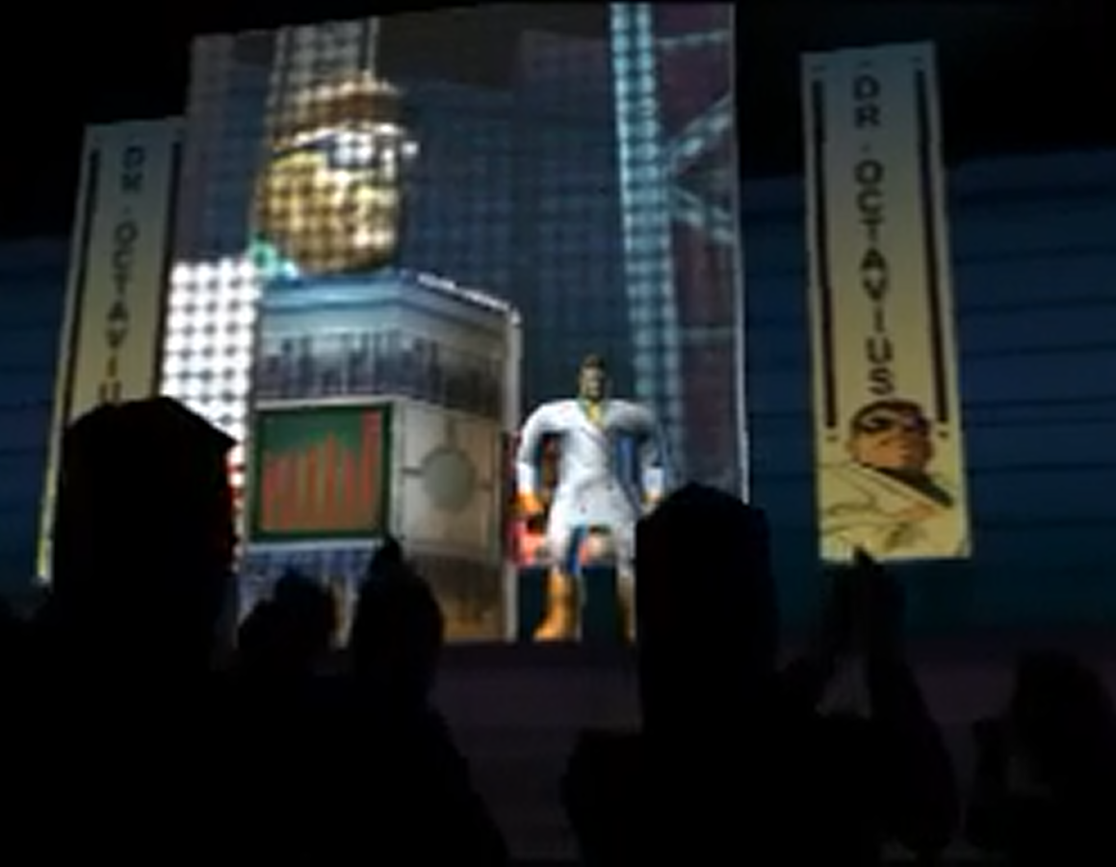
More Like This…

Slide 4
High-resolution animations and videos include thousands of pieces of code and raw-text instructions that require millions of processor instructions. To do these, render nodes are commonly used to reduce the time it takes to perform these functions, using their ability of cluster computing.
Render nodes are the building blocks to all rendering effects. By establishing small groups of render nodes (Render Farms), the rendering process is streamlined and is performed quickly.
To render means to convert things like graphics or some other given parameters into a visual representation. This can be used to generate a color on a block or create a special kind of texture.

Slide 5
Real-time rendering is one of the most common rendering type, used in interactive gaming, 3d information is transformed into actual images at a rapid pace.
These images must be rendered in Real-time in interactive gaming to anticipate what the game player will do as best it can, since a gamer’s decision on what to do can be very unpredictable.
To have the in-game motion seem fluid, the rendered frame rate on screen is generally 18-20 frames per second.

Slide 6
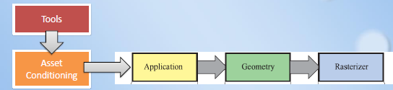
3D Pipeline
One common method that we should be familiar with is the Rendering pipeline.
First the tools are created and conditioned to the desired format to use in the rendering workspace.
After this the tools are used to create an environment and assets and shape and place them where ever they are desired.
Once the object placement is finalized, the world is rasterized. It is drawn using the generated data or per-pixel operations.

Slide 7
Key Functions
In the environment, there has to be a designated spot in the environment to project the rendered texture of the camera to. If there exists a proper screen, the command getChild(‘screen’), will project a rendered screen into the designated spot.
<viz>.addRenderTexture: Creates a blank texture over which a rendered video can be placed.
<viz>.addRenderNode: Creates a projection matrix for a render node of size = (length by width).

Slide 8
Attempted to create our own screen and apply render nodes/textures to it. However, the model made in 3DSMax could not import properly.
For our topic, Vizard has an Prefab environment with a screen set up in the “Pit”.

Slide 9
Demo
VidTextsProj.py

